Slide 1
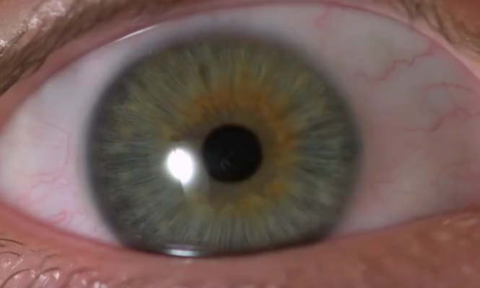
The greatest showdown of the 21st century: Pupillabs vs. Eyelink
Ehinger, Groß, Ibs & König
Notes:
Good Morning, thank you for the introduction
New paradigm to SEPARATE fixational information extraction and saccadic planning
Collaborative work with LK, JS and my supervisor PK
Let‘s jump right into it:

Slide 2
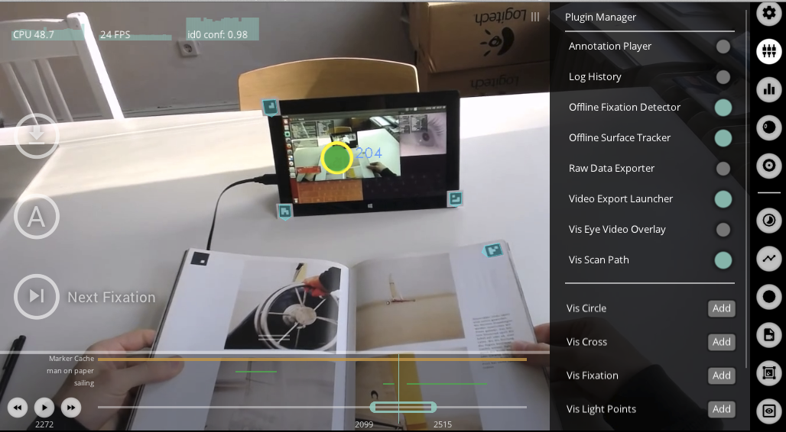
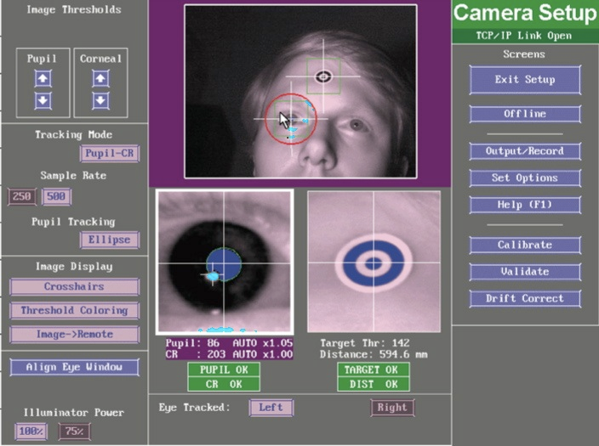
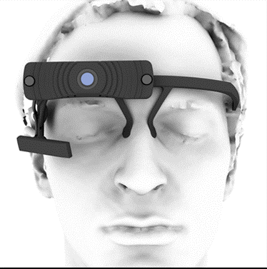
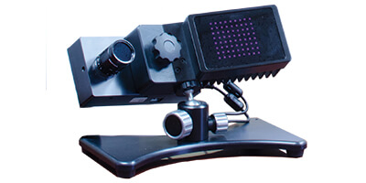
Pubillabs (PL) vs. Eyelink (EL)

Slide 3
Our test battery
repeat ~8 times => 45min
15 subjects

Slide 4
The task:
7x7 grid
Measures:
Variance of fixation (Accuracy)
Direct comparison / correlation of signals
Saccade Amplitudes + Velocities + Angles
Fixation onset latencies
Hypotheses:
EL accuracy ~0.5°, PL ~1-2°
High correlation, more NA in PL
Saccade Amplitudes + Velocities + Angles
Fixation onset latencies

Slide 5
The task:
360° (2° steps)
Speed 15-25°
200ms ramp for catchup
Measures:
Total smooth pursuit tracking time
Smooth pursuit velocity
Smooth pursuit gain (?)
Number of catchup saccades
Hypotheses:
PL higher variance in estimate
PL worse (bad temporal resolution)
EL better estimate

Slide 6

The task:
3 images / block
6 seconds / image
=> ~25s
Measures:
Mostly to make a beautiful image
Spatial bias (?)
Hypotheses:
- none -

Slide 7
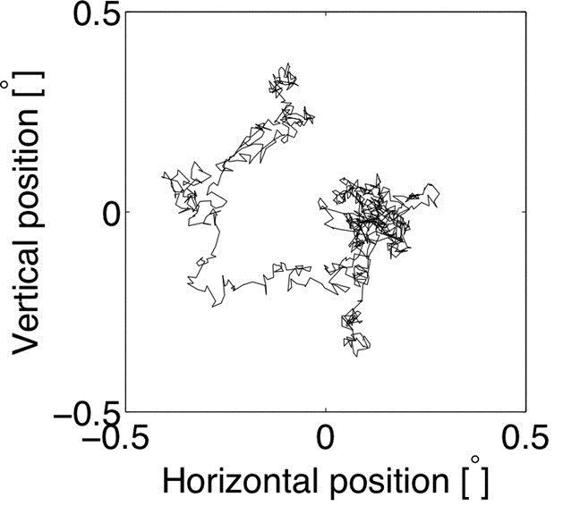
The task:
Fixation cross for 20s
Measures:
Number of micro saccades (saccades <1°)
Variance/Drift (after correcting for micro saccades)
Hypotheses:
PL does not have the resolution to
Quantify micro saccades

Slide 8
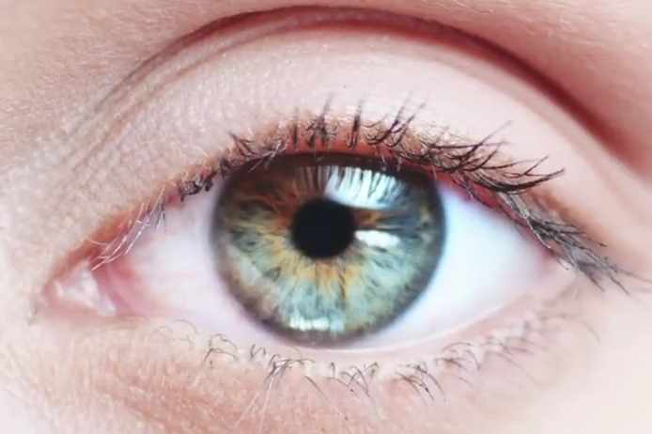
The task:
for (beep in 1:6){
if beep{
do_blink()
}
}
~6 seconds
Measures:
Number of detected blinks
Blink duration
Hypotheses:
- none -

Slide 9
The task:
Fixate on cross
25 full-field luminance changes
2s per luminance
Measures:
Pupil dilation range
Fixation accuracy (compensation for pupil size)
Hypotheses:
Psychometric curve could be different
=> PL has an angle to the pupil
PL shows stronger accuracy bias than EL

Slide 10
The task:
Fixate on the targets
Measures:
Accuracy before & after head motion
Hypotheses:
EL can compensate better
PL headset could move

Slide 11
The task:
Roll: Fixate dots with headmovements
Yaw: Rotate head to align with line
2x 5 angles => 10 trials each
Measures:
Angle when signal is lost
Hypotheses:
PL can‘t cope with roll
EL can‘t cope with yaw

Slide 12
Randomization
Large grid without full randomization:
Large grid: Same randomization for each subject
=> Minimize between subject variance
Allows for two subject comparison (e.g. small vs. Large eyes)
?? Does that make any sense at all??
Random draw
Entropy optimized
Try to maximize entropy of amplitude and angle

Slide 13
Yaw / Roll randomize over blocks, over subjects?
Small grid randomize over subjects?
Pupil dilation randomize over subjects?
Free-viewing images randomize over subjects?

Slide 14
Are we missing something?

